Slide 1
Citi Bike Data Analysis
By Suman Sekhar Meher email- rajameher111@gmail.com GitHub link(for this project)-

Slide 2
Project Goal:
To better understand the behavior of Citi Bike’s customer base (both one-time users and subscribers) and how they use Citi Bikes
This will help us to:
Identify where more bikes should be installed
Create targeted marketing campaigns that will appeal to different customer segments

Slide 3
Key questions:
What are the most popular pick-up locations across the city for Citi Bike rental?
How does the average trip duration vary across different age groups?
Which age group rents the most bikes?
How does bike rental vary across the two user groups (one-time users vs long-term subscribers) on different days of the week?
Does the factor of user age impact the average bike trip duration?

Slide 4
Findings & Insights

Slide 5
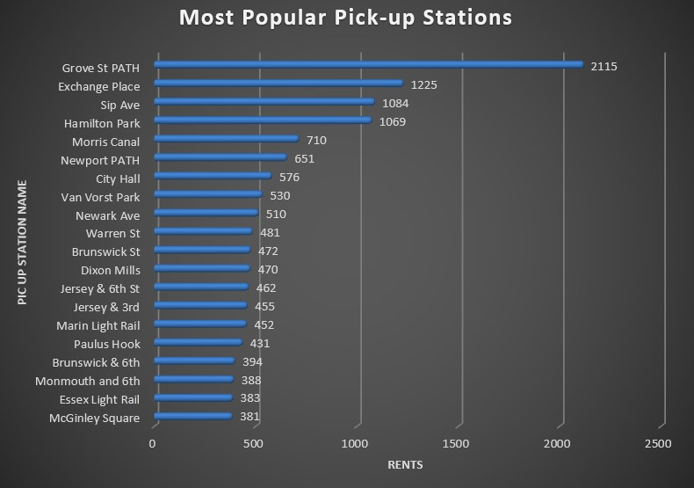
What are the most popular Citi Bike pick-up locations?
Grove St PATH is the most popular pick-up station with 2,115 rentals, significantly higher than other stations.
Exchange Place, Sip Ave, and Hamilton Park follow, with over 1,000 rentals each, showing high demand.
So, adding more bikes here would be beneficial.

Slide 6
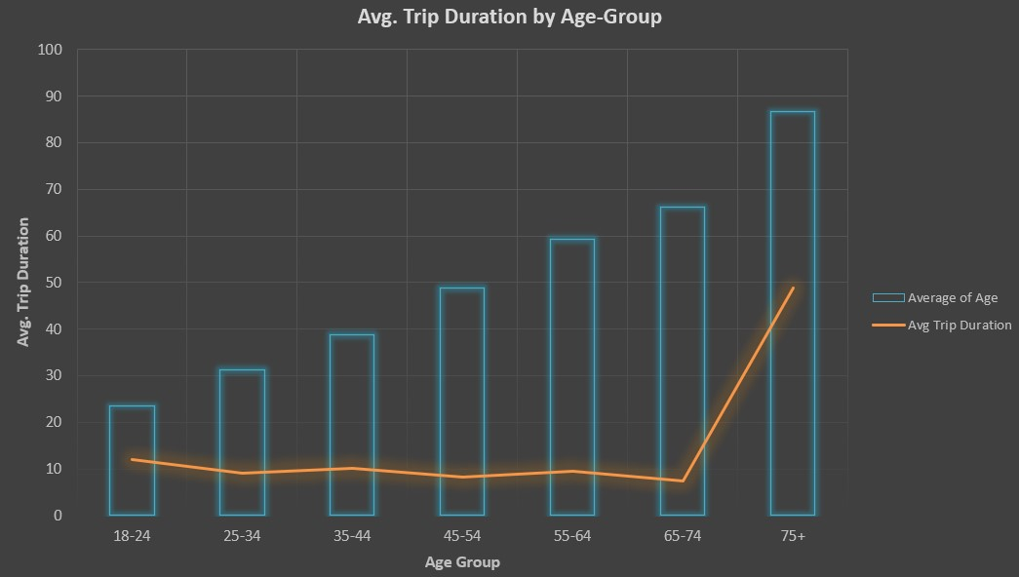
2. How does the average trip duration vary across different age groups?
Older people (75+) take the longest trips, likely due to different travel habits.
The shortest trips are in the 65-74 age group, possibly due to lifestyle or mobility changes.
This shift in travel behavior among seniors can help in planning transport and services.

Slide 7
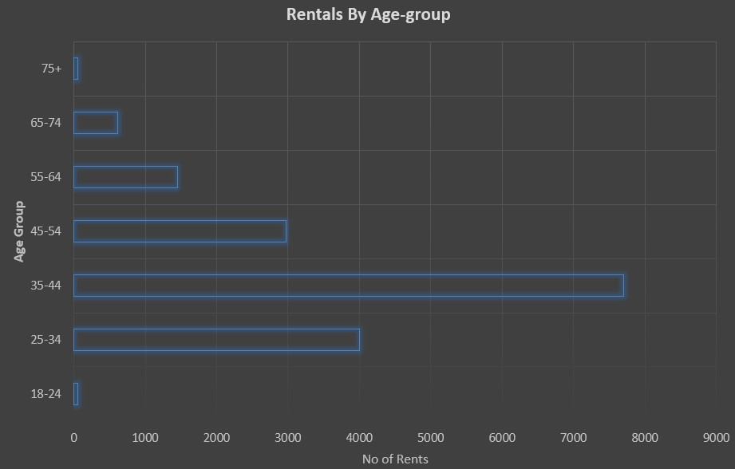
3. Which age group rents the most bikes?
The 35-44 and 25-34 age groups have the highest number of rentals, indicating they are the primary users of the bike rental service.
Bike rentals drop significantly for older age groups (55+), with very few rentals from the 75+ group, suggesting lower engagement among seniors.

Slide 8
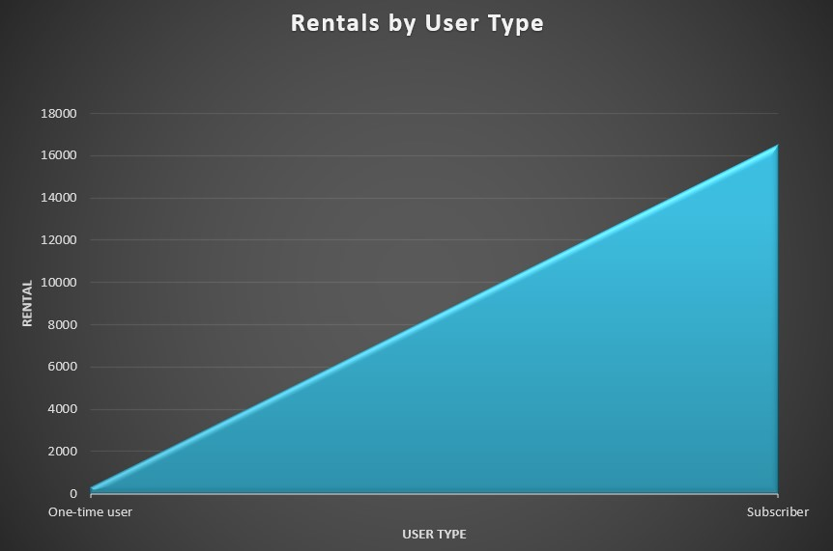
4. How does bike rental vary across the two user groups (one-time users vs long-term subscribers) on different days of the week?
Most bike rentals are from subscribers, showing they use bikes often and stay loyal.
One-time users rent bikes much less, so there is a chance to encourage them to become subscribers.

Slide 9
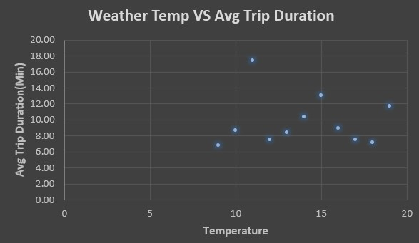
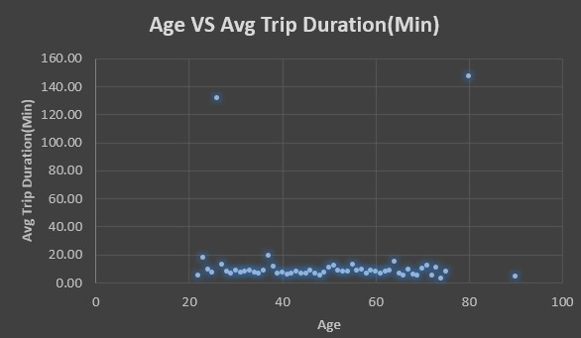
5. Do factors like weather and age impact the average bike trip duration?
As temperature increases, the average trip duration tends to increase slightly, suggesting that people prefer longer rides in warmer weather.
Most bike trips have a short duration across all ages, but there are a few extreme cases where younger and older riders take significantly longer trips.

Slide 10
Dashboard

Slide 11
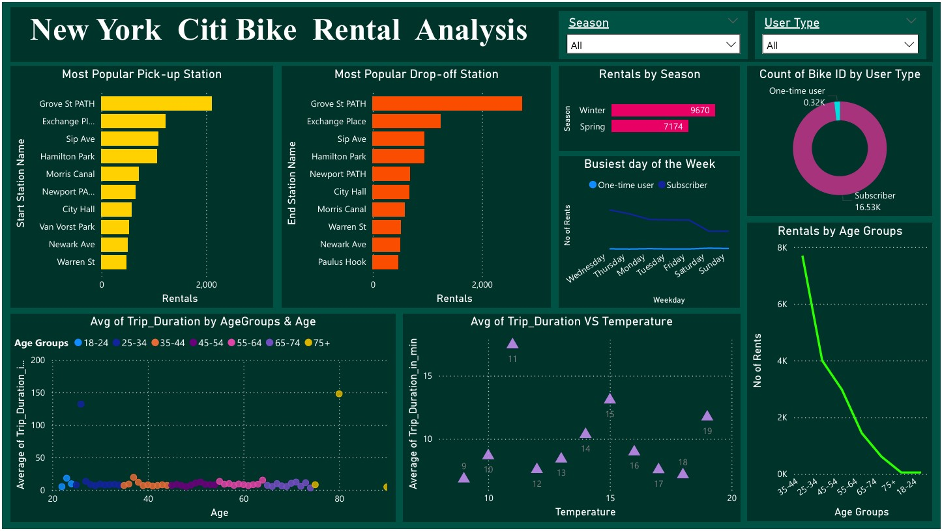
Power BI Dashboard:
This Power BI dashboard provides insights into New York Citi Bike rentals, showing popular pick-up and drop-off stations, rentals by season, user types, age group trends, and trip duration analysis.
It helps understand bike usage patterns based on factors like temperature, weekdays, and user demographics.

Slide 12
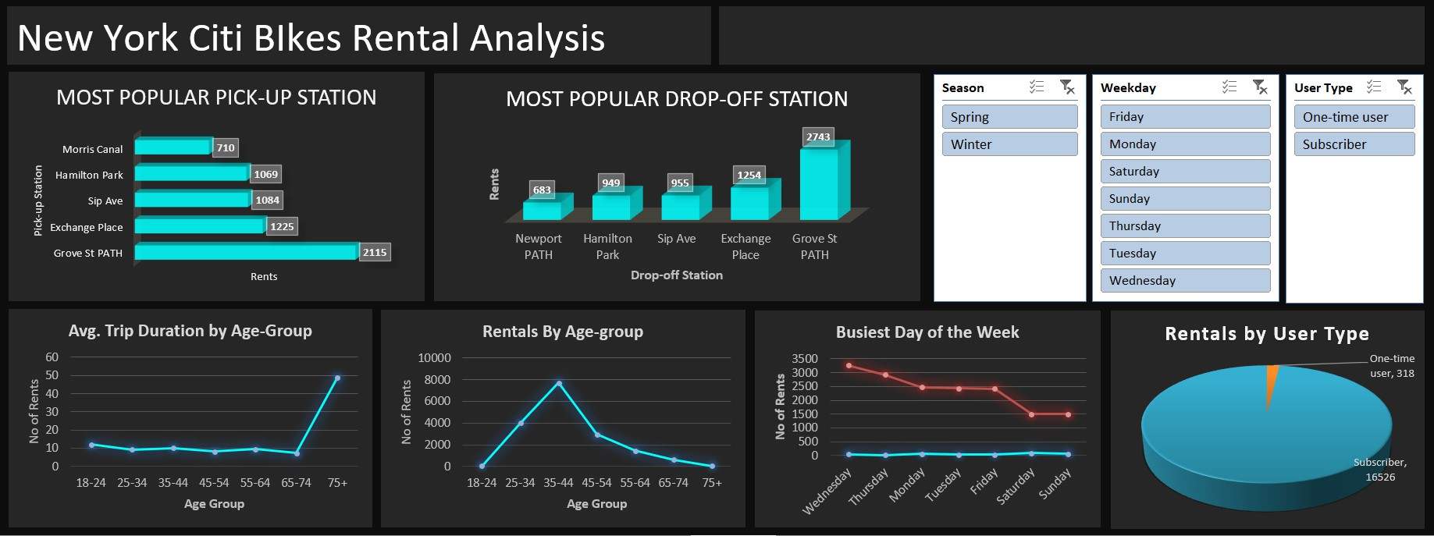
Excel Dashboard:
This Excel dashboard analyzes New York Citi Bike rentals, showing the most popular pick-up and drop-off stations, rentals by season, age group, user type, and the busiest days of the week.
It helps track bike usage trends and user behavior efficiently.

Slide 13
Summary

Slide 14
Summary of findings:
Top 5 pick-up locations for bikes:
Morris Canal, Hamilton Park, Sip Ave, Exchange Place, and Grove St PATH
Customer base:
Citi Bike's customer base mainly consists of subscribers who frequently use the service, with younger riders taking longer trips. Warmer temperatures encourage longer rides, while most trips remain short across all age groups.
Citi Bike customer behavior:
The oldest riders (75+) take the longest trips on average, while middle-aged riders (25-65) have the shortest trip durations.

Slide 15
Actions & Recommendations

Slide 16
Recommended actions:
Product recommendations:
Install more bikes at stations with high rental demand, as well as frequently used by subscribers and younger riders for regular commuting, especially at Morris Canal, Hamilton Park, Sip Ave, Exchange Place, and Grove St PATH.
Marketing recommendations:
The Citi Bike customer base is mostly subscribers, aged between 25-45, who are most active on weekdays. This suggests they are likely New York residents using Citi Bikes for commuting. Marketing efforts should focus on this group, promoting convenience and subscription benefits.

Slide 17
Thank you!

